Slide 1
Introduction to OLAP, and Association

Slide 2
Four-Dimensions of Data Mining
Data to be mined
Knowledge to be discovered
Techniques utilized
Applications adopted

Slide 3
Four-Dimensions of Data Mining
Data to be mined
Knowledge to be discovered
also known as “data mining functionalities”
Techniques utilized
Applications adopted

Slide 4
Data Mining Functionalities
Online Analytical Processing (OLAP)
Association
Classification
Prediction
Clustering
Ranking
Outlier/Anomaly detection

Slide 5
Data Mining Functionalities
Online Analytical Processing (OLAP)
Association
Classification
Prediction
Clustering
Ranking
Outlier/Anomaly detection
You will learn about each of these data mining functionalities, including their definitions, techniques to implement, and basic applications.

Slide 6
OLAP: Online Analytical Processing
Fast answering of multidimensional analytical queries
Analytical processing instead of transaction processing

Slide 7
Transactional vs Analytical Processing
Typical transactional database
T_id | Datetime | Product | Country | Quantity
1001 | 09/01/11, 01:00:23 | TV | USA | 1
1002 | 09/01/11, 02:15:16 | TV | Canada | 2
1003 | 09/02/11, 15:10:41 | PC | USA | 1
… | … | … | … | …
15691 | 03/03/12, 23:59:07 | VCR | Mexico | 1
… | … | … | … | …

Slide 8
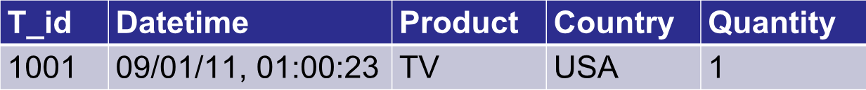
Transactional vs Analytical Processing
Typical transactional database table and records
T_id | Datetime | Product | Country | Quantity
1001 | 09/01/11, 01:00:23 | TV | USA | 1
1002 | 09/01/11, 02:15:16 | TV | Canada | 2
1003 | 09/02/11, 15:10:41 | PC | USA | 1
… | … | … | … | …
15691 | 03/03/12, 23:59:07 | VCR | Mexico | 1
… | … | … | … | …

Slide 9
Transactional vs Analytical Processing
Easy to query instances of transactions
“How many TVs were sold in total?”
T_id | Datetime | Product | Country | Quantity
1001 | 09/01/11, 01:00:23 | TV | USA | 1
1002 | 09/01/11, 02:15:16 | TV | Canada | 2
1003 | 09/02/11, 15:10:41 | PC | USA | 1
… | … | … | … | …
15691 | 03/03/12, 23:59:07 | VCR | Mexico | 1
… | … | … | … | …

Slide 10
Transactional vs Analytical Processing
What about analytical queries that support business decisions?
T_id | Datetime | Product | Country | Quantity
1001 | 09/01/11, 01:00:23 | TV | USA | 1
1002 | 09/01/11, 02:15:16 | TV | Canada | 2
1003 | 09/02/11, 15:10:41 | PC | USA | 1
… | … | … | … | …
15691 | 03/03/12, 23:59:07 | VCR | Mexico | 1
… | … | … | … | …
Query: how many TVs were sold in the second quarter of 2011 in North America?

Slide 11
Transactional vs Analytical Processing
Transactional databases are not suitable for answering analytical queries.
T_id | Datetime | Product | Country | Quantity
1001 | 09/01/11, 01:00:23 | TV | USA | 1
1002 | 09/01/11, 02:15:16 | TV | Canada | 2
1003 | 09/02/11, 15:10:41 | PC | USA | 1
… | … | … | … | …
15691 | 03/03/12, 23:59:07 | VCR | Mexico | 1
… | … | … | … | …
Query: how many TVs were sold in the second quarter of 2011 in North America?

Slide 12
OLAP: Online Analytical Processing
Techniques
Data Warehouse:
Data Cubing:

Slide 13
OLAP: Online Analytical Processing
Techniques
Data Warehouse: Infrastructure that integrates multiple types of transactional data and processes data for analysis.
Data Cubing:

Slide 14
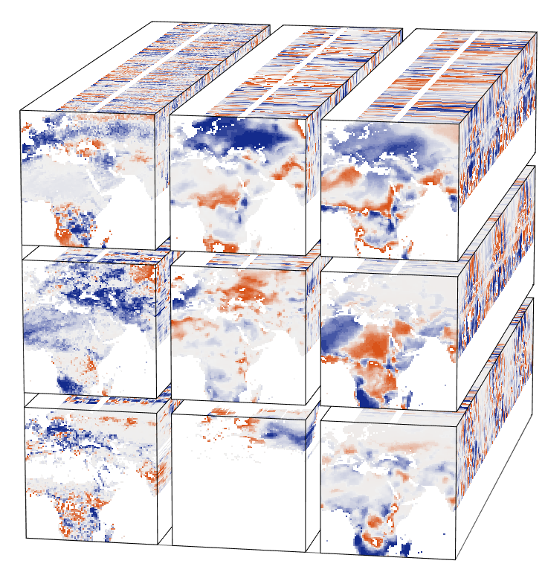
OLAP: Online Analytical Processing
Techniques
Data Warehouse: Infrastructure that integrates multiple types of transactional data and processes data for analysis.
Data Cubing: Pre-aggregate transactional data for use in future queries; improves efficiencies.
http://earthsystemdatacube.net/

Slide 15
OLAP: Online Analytical Processing
Application
Business Intelligence

Slide 16
Association
Finding inherent regularities and relations in big data
→
(80% confident)

Slide 17
Association
Techniques: Co-occurrence analysis, correlation analysis, and causal inference.

Slide 18
Association
Applications: Basket data analysis, catalog design, advertisement, and search engine log analysis.

Slide 19
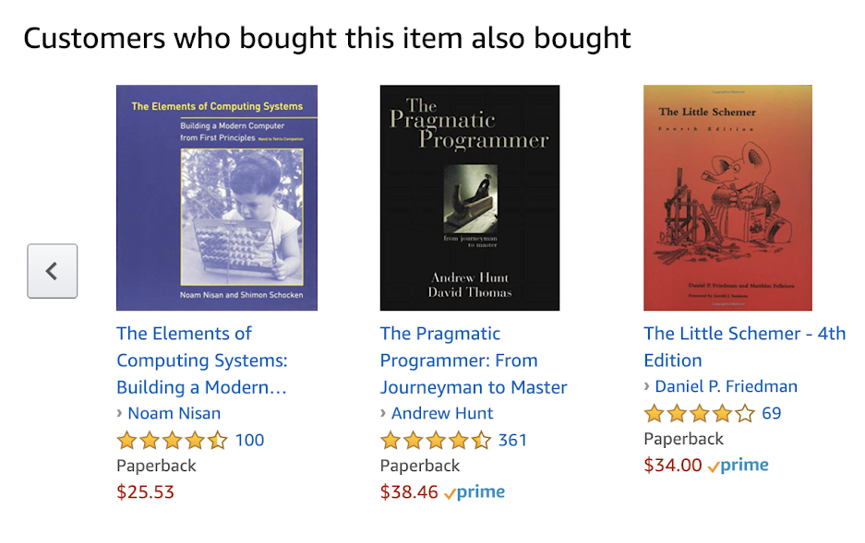
Association
Applications: Basket data analysis, catalog design, advertisement, and search engine log analysis.

Slide 20
Association
Applications: Basket data analysis, catalog design, advertisement, and search engine log analysis.
“What are the best combination of keywords that are associated with my search engine ad?”

Slide 21


School of Information, University of Michigan
Qiaozhu Mei
School of Information
All Content © Presenter

